Slide 1
Fraternal Benefits
Notes:
Welcome, everyone! Thanks for attending this [Summit chapter/chapter] educational event.
For those of you who aren’t currently members of Modern Woodmen of America, we’re glad you’re here. Educational programs are just one of the many ways Modern Woodmen gives back to the community. Please see me after this program if you’d like to learn more.
[Today’s/Tonight’s] topic is fraternal benefits. We’ll cover many of the benefits and discount programs available exclusively to Modern Woodmen members.

Slide 2
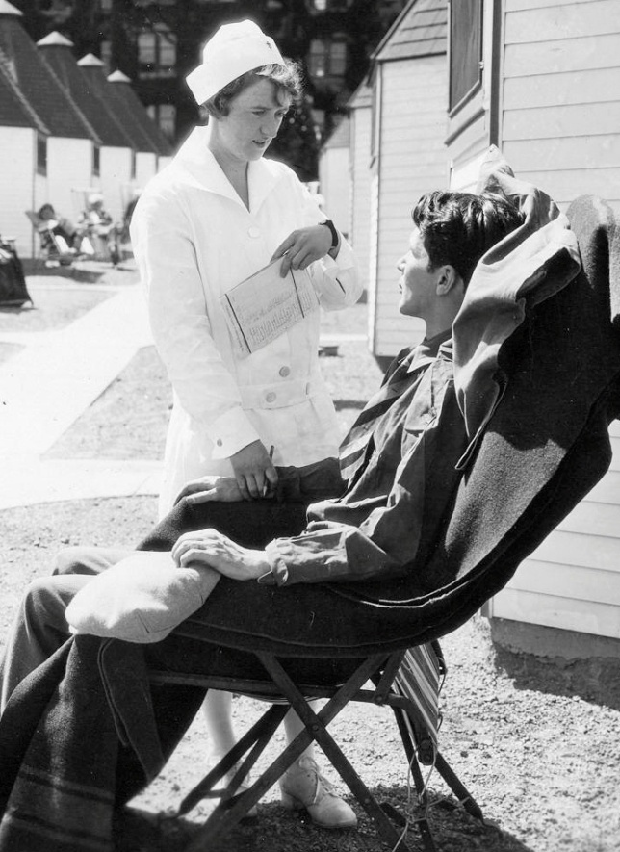
Fraternal benefits history
Tuberculosis sanatorium.
Free treatment for members.
Healthy food, exercise, rest and health education.
75% recovery rate.
Notes:
Let’s start at the beginning.
Modern Woodmen’s very first fraternal benefit included treatment at its tuberculosis sanatorium. (In case you’re wondering, a sanatorium is a hospital that treats chronic diseases like tuberculosis.)
In the 18th and 19th centuries, tuberculosis was a near-epidemic in the Western world. In fact, at the turn of the 20th century, tuberculosis – also known as the “white plague” or consumption – was the leading cause of death for Modern Woodmen members. In response, Modern Woodmen opened a tuberculosis sanatorium in Woodmen, Colorado – just north of Colorado Springs – on Jan. 1, 1909. Any beneficial member with tuberculosis could receive treatment at the sanatorium free of charge.
The treatment included rest, wholesome food, pure air, exercise and health education. This resulted in a 75% recovery rate among the 12,000 patients who eventually sought treatment at the sanatorium.
The sanatorium was also the site of research and education, which led to the development of vaccines and antibiotics that helped reduce the incidence of tuberculosis in the United States. As a result, the need for the sanatorium declined, and the facility closed in 1947.

Slide 3
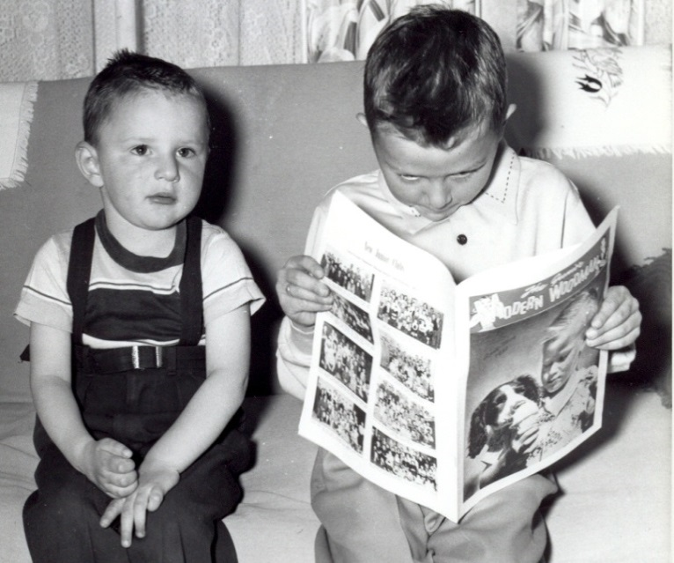
Fraternal benefits history
Polio-Protection Plus.
$250 benefit.
Additional $250 for disability or death.
Health education in member magazine.
Notes:
Fast-forward to Jan. 1, 1951, when Modern Woodmen introduced its Polio-Protection Plus benefit. This member benefit was introduced at a time when the incidence of polio was increasing. In fact, the following year, 58,000 cases of polio were reported – the most ever.
Modern Woodmen granted a fraternal benefit of $250 to any member who contracted polio. If the disease left the member permanently disabled, or if the member died, an additional $250 was paid.
In an effort to help members preserve their health, Modern Woodmen began publishing a series of articles about polio and other chronic diseases in its member magazine.
Three-year-old Timmy Weber from Greeley, Colorado, received the first Polio-Protection Plus benefit in 1951. He’s pictured here with an older brother.
With the eradication of polio in the U.S. by the 1970s, the Polio-Protection Plus benefit was discontinued.

Slide 4
Fraternal benefits today
Notes:
Today, Modern Woodmen’s mission to help members improve their quality of life continues. As one of America’s largest fraternal financial services organizations, we exist for the benefit of our members.
We support families by providing social, educational and volunteer opportunities for our members and their children. We also strengthen communities by sponsoring fundraisers and volunteer projects.
And we still provide fraternal benefits for our members. These benefits are designed to fulfill our mission by helping members and their families in good times and in times of need.
Now, let’s review what’s currently available.

Slide 5
Anytime Fitness®
Free 7-day trial pass.
50% off enrollment.
10% off monthly dues.
24/7/365 access to 2,100 locations.
Notes:
The Anytime Fitness® benefit offers Modern Woodmen members a:
Free seven-day trial pass.
50 percent discount on standard enrollment fees.
10 percent discount on monthly dues for basic membership.
Anytime Fitness® members have 24/7 access, 365 days a year to more than 2,100 Anytime Fitness locations nationwide. Members may use other Anytime Fitness® facilities at no extra charge.
Most facilities also offer personal training and tanning services.

Slide 6
Birthday Book Club
Free books for kids ages 1-16 during their birthday months.
Households where all members are beneficial members.
Available through Modern Woodmen reps.
Notes:
The Birthday Book Club provides free, age-appropriate books for children ages 1 to 16. To qualify, kids must be part of a household in which all parents, legal guardians and children under age 18 are beneficial members of Modern Woodmen.
The wholesome, high-quality books feature classic tales, contemporary fiction and educational resources. They’re mailed directly to the child’s home during his or her birthday month each year.
This benefit is available primarily through your Modern Woodmen representative.

Slide 7
Do-Good Grant ®
For beneficial members over age 16.
$100 for hands-on service project.
Up to 500 grants awarded annually.
Notes:
The Do-Good Grant® helps beneficial members over age 16 coordinate a small-scale volunteer project with family and friends. Up to 500 grants are awarded annually on a first-come, first-served basis.
Do-Good Grant® projects must be hands-on, benefit a local public or nonprofit organization, and be carried out independently of existing chapter, Summit chapter and youth service club activities.
If your grant application is approved, you’ll receive:
A $100 prepaid VISA® card to purchase project supplies and materials.
Do-Good Crew T-shirts for up to five participants.
A helpful project guide.
More resources to help make your project a success.
Members can check eligibility requirements and apply for a grant online at member.modernwoodmen.org (under “Fraternal Benefits”).

Slide 8
Final Wishes Resources
Help for late-in-life and end-of-life planning.
My Life, My Plan workbook.
My Life, My Plan – A Helper’s Guide
Contact your rep.
Notes:
Late-in-life and end-of-life planning is important. You may be reluctant to discuss the topic with your loved ones, but doing so can clear up confusion and anxiety.
The Final Wishes Resources benefit offers help for both sides of the conversation. You can choose from two handy (and free!) resources, available exclusively to Modern Woodmen members.
The My Life, My Plan workbook is an easy-to-follow guide that breaks late-in-life/end-of-life planning down into manageable, bite-size chunks. Work through defined steps to help get your house in order, organize your affairs and record your wishes for your loved ones.
My Life, My Plan – A Helper’s Guide provides advice for those who want to help a parent, spouse, relative or friend prepare his/her final wishes. The guide offers tips for holding end-of-life planning conversations and helps prepare you for the eventual loss of a loved one.
Talk to your Modern Woodmen rep to order one or both resources.

Slide 9
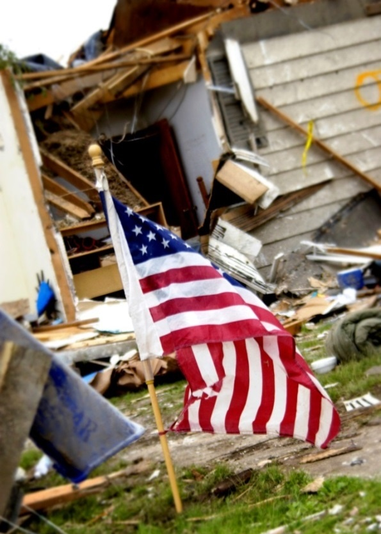
Fraternal Aid Fund
Life insurance premiums paid for a limited time.
Illness, accident, fire, natural disaster.
Granted by need.
May apply twice in 5 years.
Notes:
The Fraternal Aid Fund offers premium payment assistance to help keep your life insurance contract in force during times of hardship.
You may qualify to have your premiums covered in the event of illness, accident, fire or natural disaster.
Requests are granted on the basis of need and the inability to pay premiums.
Members can apply for fraternal aid twice in five years.
If approved, Modern Woodmen will apply Fraternal Aid to all life certificates owned and paid for by the member and/or the member’s spouse.

Slide 10
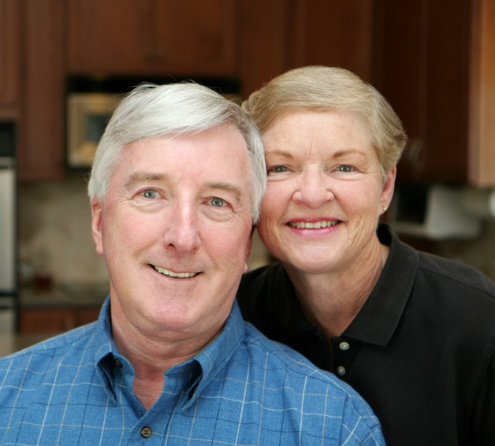
Life Line Screening®
Screens for stroke, diabetes and more.
For members ages 50-80.
Reduced cost of $129.
Notes:
Life Line Screening® helps people become aware of unrecognized cardiovascular problems, osteoporosis, diabetes and much more.
When a Life Line Screening® is scheduled in their community, Modern Woodmen members ages 50-80 can participate at a reduced cost of $129. Letters sent to members contain complete instructions for participation.
The screenings are performed by highly trained health care professionals using advanced ultrasound equipment. Results are reviewed by board-certified physicians to ensure the highest standards.

Slide 11
Make An Impact® Scholarships
198 one-time scholarships.
$450,000 awarded to students each year!
Notes:
Modern Woodmen awards $450,000 each year in a scholarship competition for member students. Make An Impact® Scholarships help with the rising cost of higher education, while recognizing our young members’ hard work and volunteer service.
Each year, 198 graduating seniors win up to $10,000 for college. An independent panel of judges select 33 winners from each of six geographic regions.
Since the competition is open exclusively to Modern Woodmen member students, the odds of winning are greater than many national award programs.

Slide 12
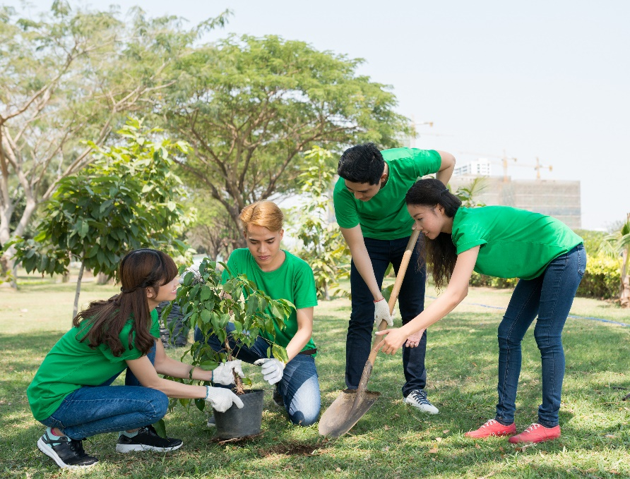
Make An Impact® Scholarships
Volunteer service is important – 40 hours in last 2 years.
Minimum GPA required.
Must have life insurance for 2 years.
Apply online.
Notes:
As a fraternal financial services organization, Modern Woodmen emphasizes fraternalism, or giving back to others. That’s why volunteer service is such an important factor in this scholarship competition. All applicants must have completed at least 40 hours of volunteer service in the past two years.
Two scholarship tracks are available to eligible member students.
For track 1, winners are chosen based on volunteer experience and academic achievement. Applicants must have a GPA of 3.5 or better. Forty-eight winners receive onetime scholarships of $10,000, $7,500, $5,000 or $2,500.
For track 2, Modern Woodmen awards $1,000 scholarships to 150 well-rounded students who are making a difference in their communities through volunteering. Track 2 applicants must have a GPA of 2.5 or better.
To be eligible for the Make An Impact® Scholarships competition, students must have their own Modern Woodmen life insurance certificates at least two years prior to Jan. 1 of their graduating year of high school. (Students who are social members or who only own annuities cannot qualify for a Modern Woodmen scholarship.)
You can find complete details about Make An Impact® Scholarships – including a link to the online application – when you log in to your online member account at member.modernwoodmen.org.

Slide 13
National Parks Pass
For members 62 and older.
Access to more than 2,000 parks and other sites.
$5 reimbursement.
Apply on-site, by mail or online.
Notes:
Through Modern Woodmen’s National Parks Pass benefit, members can receive a $5 reimbursement of fees associated with:
The America the Beautiful Parks and Federal Recreational Lands Lifetime Senior Pass (which costs $80).
OR the Annual Senior Pass (which costs $20).
Each pass is available to U.S. citizens or permanent residents age 62 or older. Use the pass at more than 2,000 federal recreational sites, including national parks, national wildlife refuges and many national forest lands.
The senior pass admits the pass owner and additional adults traveling with him or her. It may also offer a discount on other fees, such as camping.
Once you receive your pass, simply print and complete the reimbursement form found under “Fraternal Benefits” after you log in to member.modernwoodmen.org. Return the form to Modern Woodmen’s home office, along with a copy of your park pass purchase receipt. One reimbursement per household.

Slide 14
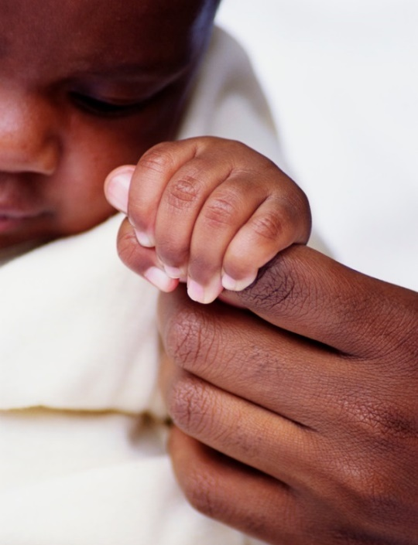
Newborn Benefit
For parents of infants in poor health.
Permanent life insurance – issued at standard rates, regardless of health.
Additional coverage at 16 and 21.
$5,000 in case of tragedy.
Notes:
The Newborn Benefit helps ensure members can obtain permanent life insurance coverage for their newborns … regardless of their current health. It also ensures they can obtain additional coverage later … regardless of their future health.
Parents of infants born in poor health can apply for $5,000 of permanent life insurance for their child. The coverage is issued at standard rates – regardless of health – and becomes effective no later than the newborn’s 181st day of life.
If the life insurance is kept in force, an additional $5,000 of coverage is offered at age 16 and $10,000 at age 21 – again at standard rates and regardless of health.
In case of tragedy before the newborn’s 181st day of life, the benefit provides $5,000 to help with medical or funeral costs. The payment is provided to the parent or parents who are beneficial members of Modern Woodmen at the time of the child’s death.

Slide 15
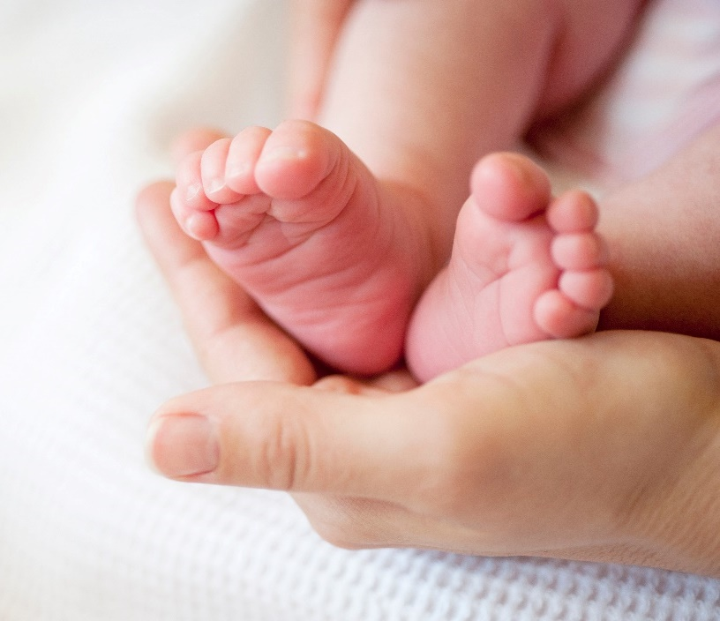
Newborn Benefit
1 parent must have insurance 6 months prior to child’s birth.
All certificates must be in good standing at birth.
Notes:
To qualify for the Newborn Benefit, one of the parents must have been a member of Modern Woodmen with a life insurance contract in force for six months immediately preceding the birth of the child.
All certificates must be in good standing at the time of the new child’s birth.

Slide 16
Orphan Benefit
For members’ children orphaned before age 19.
Monthly payments of $200-$300.
Payments continue through childhood.
$16,000 education grant.
Notes:
No one wants to think about leaving their kids without parents, but it happens. And Modern Woodmen will help financially support them if it does.
If a child is orphaned, and one of the parents was a beneficial member of Modern Woodmen, the Orphan Benefit can help provide financial support for his or her care and education. The child’s guardian receives monthly support payments of $200-$300, depending on the child’s age.
Benefit payments begin one month after approval by Modern Woodmen. They continue until the orphan becomes self-supporting, marries, reaches age 19, or enrolls in college under the benefit’s education grant.
When the orphan is accepted by an accredited college, university or vocational institution, Modern Woodmen pays up to $4,000 each school year for four years, as long as the student maintains acceptable grades.

Slide 17
Orphan Benefit
Last surviving legal parent must have been a member with life insurance for at least 6 months.
Notes:
To be eligible for the Orphan Benefit, the last surviving legal parent must have been a Modern Woodmen member with a life insurance contract in force for six months prior to his or her death.

Slide 18
PerkSpot
Exclusive discount hub.
View by:
Category.
Brand.
Preferences.
Notes:
Switching gears completely, we have Modern Woodmen’s PerkSpot benefit.
Available via desktop, tablet or smartphone, PerkSpot is an exclusive discount hub for some of our members’ favorite national and local merchants. Members can save on thousands of products, services and experiences – from electronics, apparel and food to pet supplies, entertainment, travel and more.
Members can view discounts by category, brand or preferences and use the local map tool to discover discounts near them.

Slide 19
ScriptSave® WellRx Premier
Prescription savings card.
Honored at numerous pharmacies.
Discounts on medications, vision care, health supplies and more.
Notes:
Modern Woodmen members and their families can access prescription and other health care savings through the ScriptSave® WellRx Premier benefit. Those who enroll receive a ScriptSave prescription savings card, honored by more than 62,000 pharmacies across the country.
This member benefit is not health insurance, but it can be helpful for those who have no prescription drug coverage or who have a plan that has a deductible, a maximum limit or doesn’t cover certain medicines.
In addition to medications, members can receive discounts on vision care, hearing care, diabetic supplies, lab testing and more.

Slide 20
Terminal Illness Interest Relief
Rider required.
Up to $5,000 lien interest waived in first year.
Automatically applied as one-time payment.
Notes:
Qualifying members diagnosed with a terminal illness can receive a portion of their life insurance proceeds in advance. This money can be used to help with medical costs and alleviate other immediate financial worries.
The advance is treated as a lien against the contract and requires the member to pay interest. However, through the Terminal Illness Interest Relief fraternal benefit, Modern Woodmen will pay up to $5,000 of the accrued interest on the member’s cumulative terminal illness lien.
This benefit is available to beneficial members who elect to use the accelerated benefits rider or terminal illness accelerated benefit rider attached to their certificate. Accelerated benefits are not available in all states or situations.

Slide 21
Access your benefits
Go to member.modernwoodmen.org.
Talk to your Modern Woodmen representative.
Call the Service Center at 309-558-3077 or 800-447-9811.
Notes:
Now that you know a little more about the benefits available to Modern Woodmen members, how do you access them?
You have several options.
Log in to your online member account at member.modernwoodmen.org and go to the Fraternal Benefits section. (This site is also accessible through a convenient mobile app.) You can find complete details about all of the benefits available and access application forms for many of the benefits.
Talk to your local Modern Woodmen representative, who can answer questions about member benefits and will be happy to help you with your request.
Call the Service Center at Modern Woodmen’s headquarters at 309-558-3077 or 800-447-9811. Service Center representatives are available 8:00 a.m.-4:30 p.m., Monday through Friday, Central time.

Slide 22
Thank you for coming!
Subject to change, fraternal benefits are not part of the insurance contract and may have specific eligibility requirements. Some benefits are not available to all members.
Notes:
Thanks again for joining us for this presentation on Modern Woodmen’s fraternal benefits.
We look forward to seeing you at our next [Summit Chapter/chapter] event! [Offer the time and place.]

